Slide 1

INTRODUCTION TO
NATURAL LANGUAGE PROCESSING

Slide 2
NATURAL LANGUAGE PROCESSING (NLP)
It is a subfield of artificial intelligence that studies the problems of automated generation and understanding of natural human languages (spoken and written).
The main tools in the applications of LT are Knowledge Based Systems (KBS), as for example ontologies, thesauri, corpora, electronic dictionaries.

Slide 3
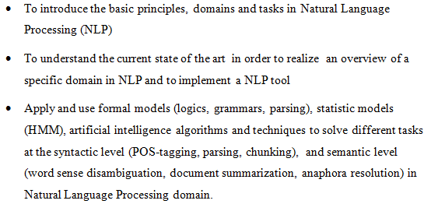
OBJECTIVES

Slide 4
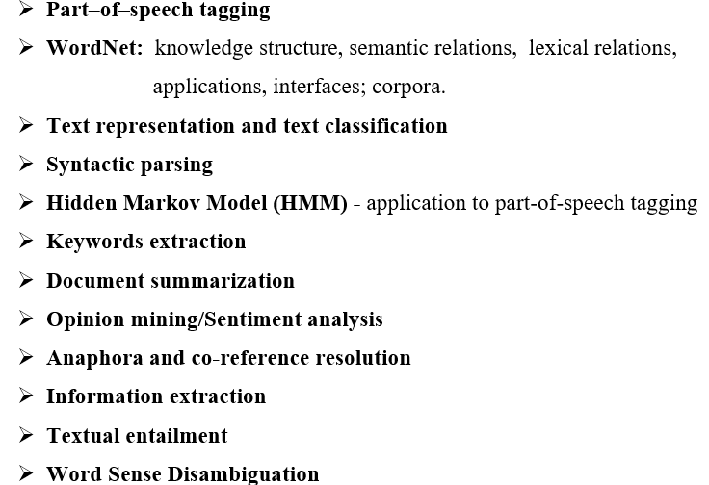
CONTENT

Slide 5
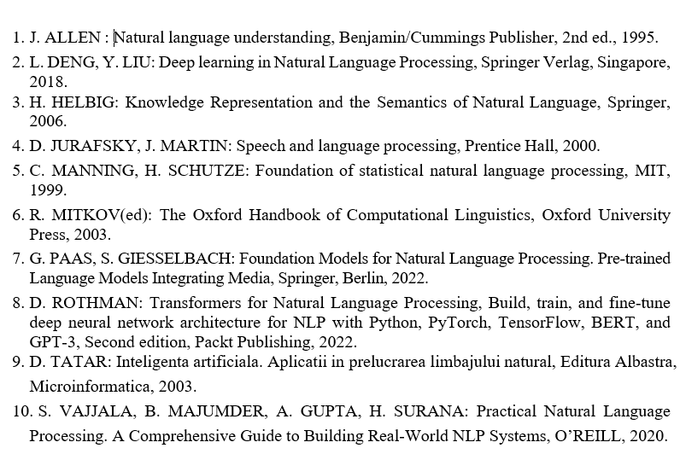
BIBLIOGRAPHY

Slide 6
DIDACTIC ACTIVITIES
Microsoft Teams platform, OPTIONAL-NLP, 2024-2025 team is used for lectures, seminars and assignments.
All the materials for lectures and seminars will be uploaded on
General channel, Files tab, Class Materials folder.
Each student will create a folder with her/his name on General channel, Files.
Attendance at the lab classes is mandatory for at least 90% (minimum 5 out of 6).

Slide 7
ASSESMENT
The final grade is based on:
35% - presentation of a NLP domain and a corresponding
tool for English/Romanian language.
35% - practical project –implementation of a NLP tool based on the studied algorithms
20% - develop linguistic resources for Romanian language
10% - active attendance at the courses

Slide 8
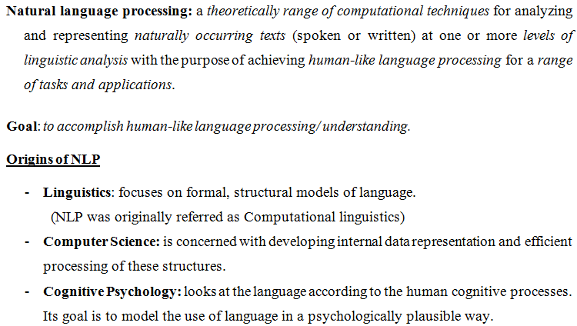

Slide 9
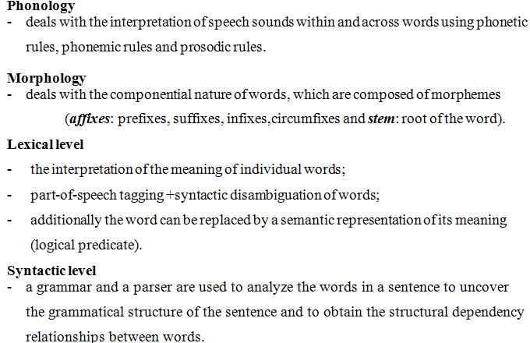
LEVELS OF NATURAL LANGUAGE PROCESSING

Slide 10
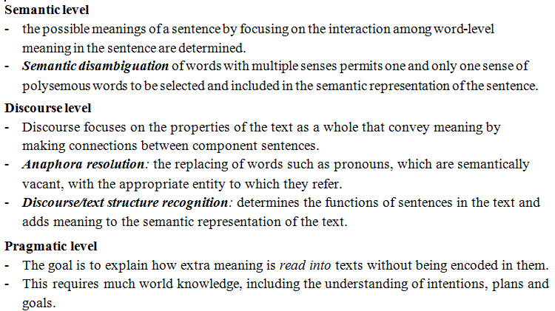
LEVELS OF NATURAL LANGUAGE PROCESSING (CONTD.)

Slide 11
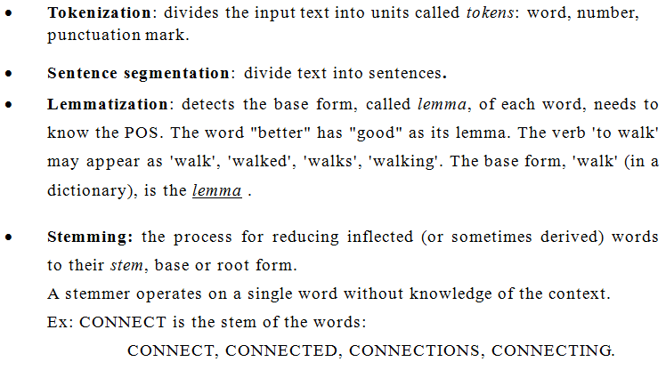
BASIC TASKS FOR WRITTEN LANGUAGES PROCESSING:

Slide 12
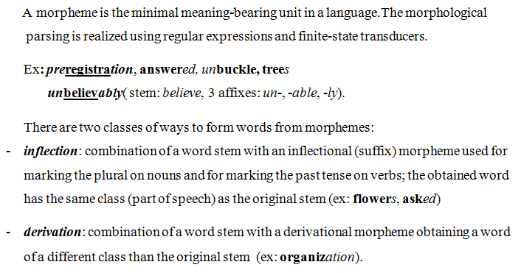
STEMMING

Slide 13
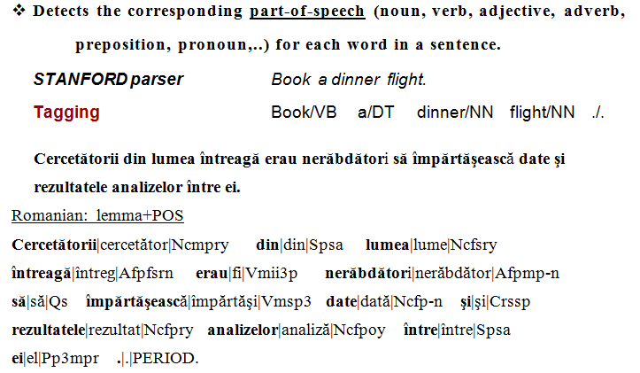
POS (PART-OF-SPEECH) TAGGING

Slide 14
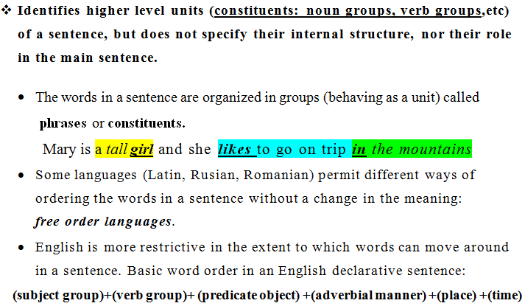
CHUNKING (SHALLOW PARSING)

Slide 15
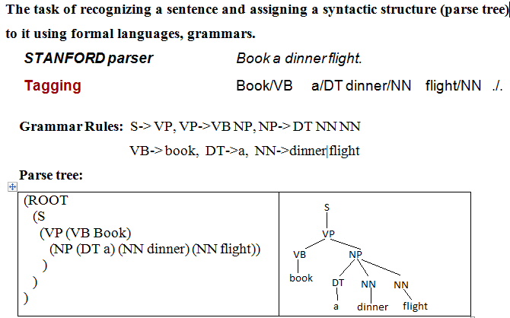
SYNTACTIC PARSING

Slide 16
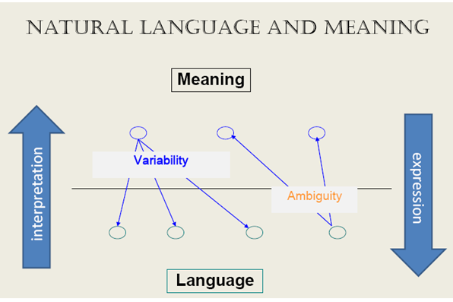

Slide 17
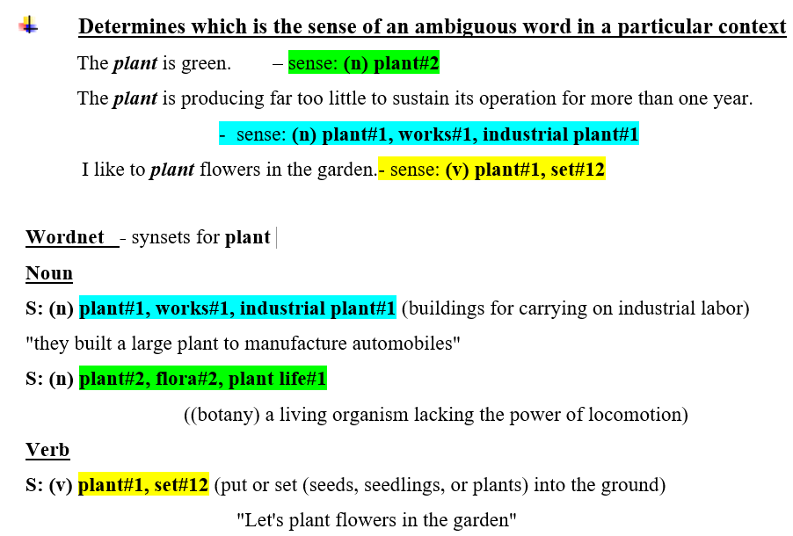
WORD SENSE DISAMBIGUATION

Slide 18
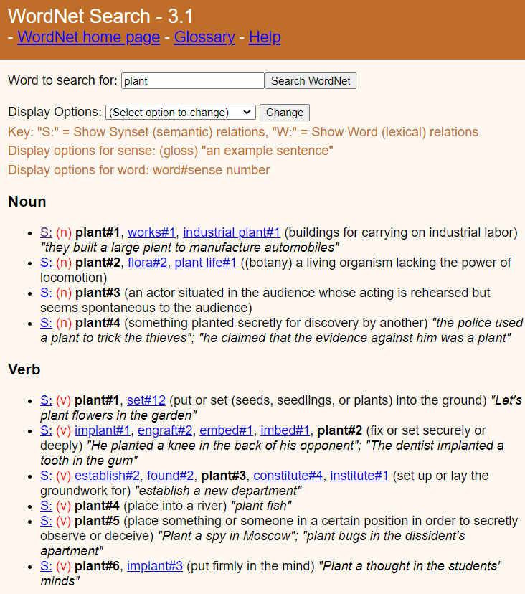

Slide 19
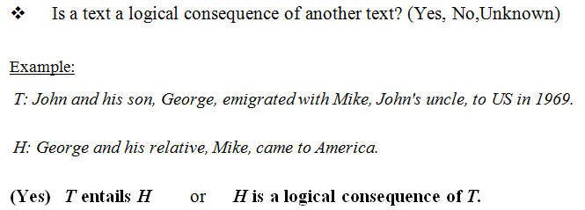
TEXTUAL ENTAILMENT PROBLEM

Slide 20
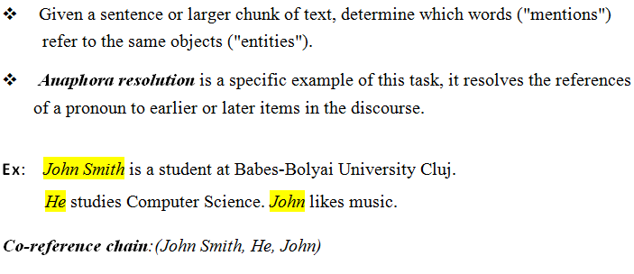
CO-REFERENCE RESOLUTION

Slide 21
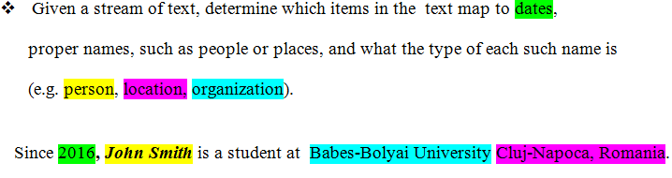
NAMED ENTITY RECOGNITION (NER):

Slide 22
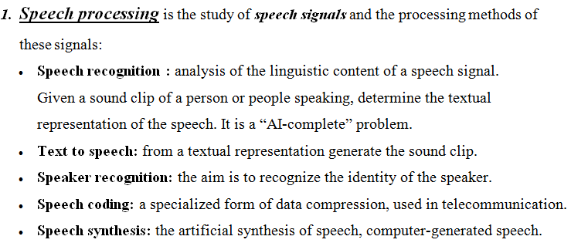
PRACTICAL TASKS

Slide 23
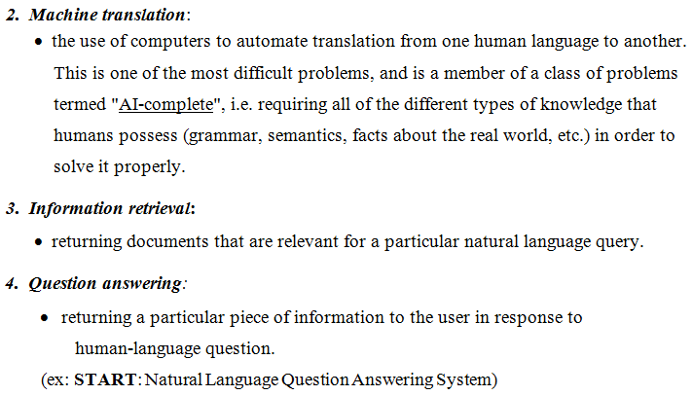
PRACTICAL TASKS (CONTD.)

Slide 24
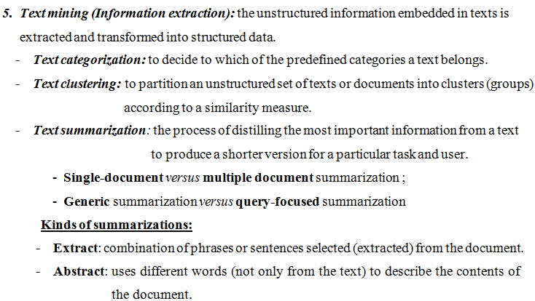
PRACTICAL TASKS (CONTD.)

Slide 25
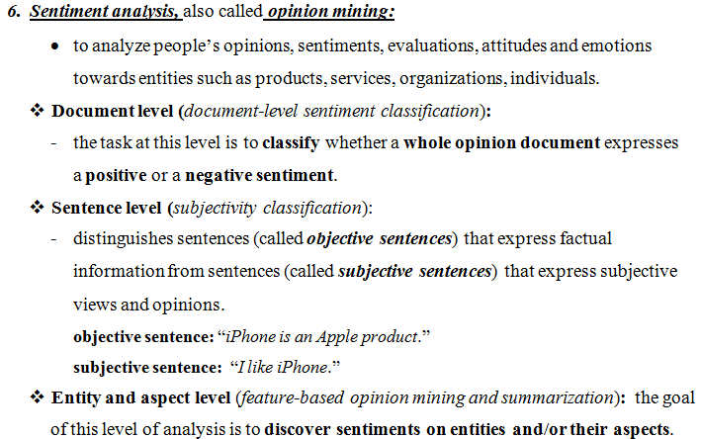
PRACTICAL TASKS (CONTD.)

Slide 26
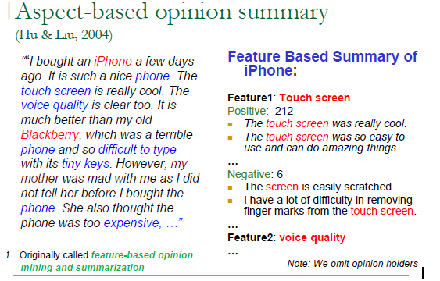

Slide 27
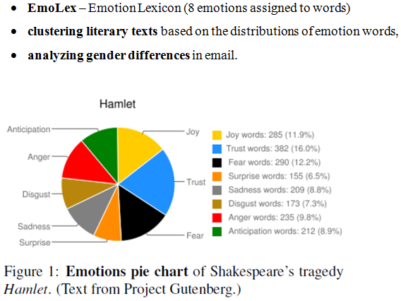
EMOTION ANALYSIS

Slide 28
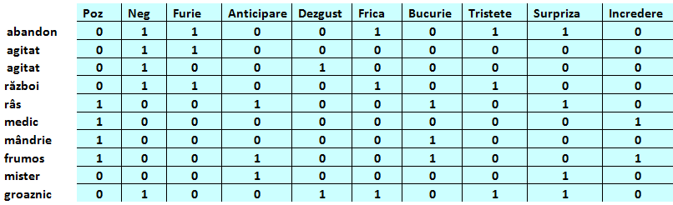
LEXICON DE EMOŢII

Slide 29
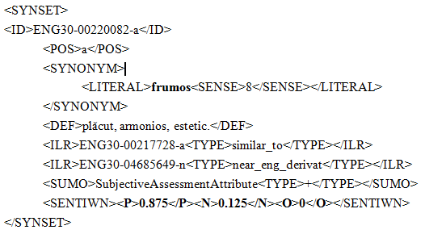
POLARITY SCORES IN ROWORDNET

Slide 30
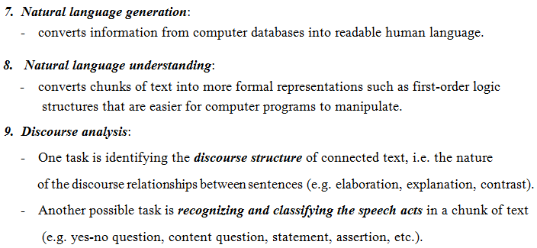
PRACTICAL TASKS (CONTD.)

Slide 31
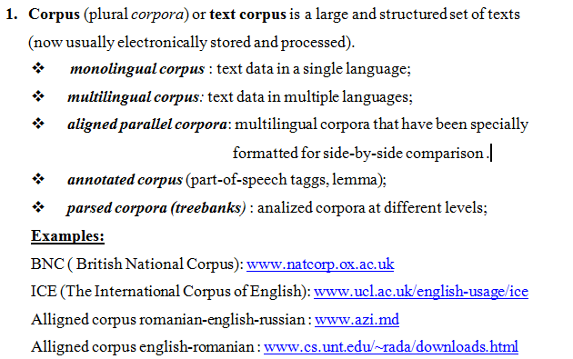
KNOWLEDGE BASES USED IN NLP
CORPORA, ELECTRONIC DICTIONARIES, THESAURI, ONTOLOGIES

Slide 32
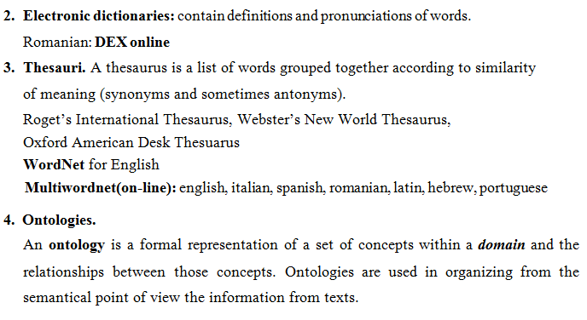
KNOWLEDGE BASES USED IN NLP

Slide 33
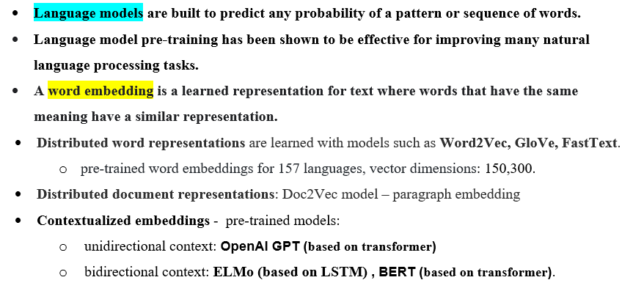
LANGUAGE MODELS

Slide 34
LARGE LANGUAGE MODELS (LLMS)
They are a category of foundation models trained on immense amounts of data making them capable of understanding and generating natural language and other types of content to perform a wide range of tasks.
They have the ability to infer from context, generate coherent and contextually relevant responses, translate to languages other than English, summarize text, answer questions (general conversation and FAQs).
These models are typically based on a transformer architecture, like the generative pre-trained transformer, which excels at handling sequential data like text input. LLMs consist of multiple layers of neural networks, each with parameters that can be fine-tuned during training, which are enhanced further by a numerous layer known as the attention mechanism, which dials in on specific parts of data sets.

Slide 35
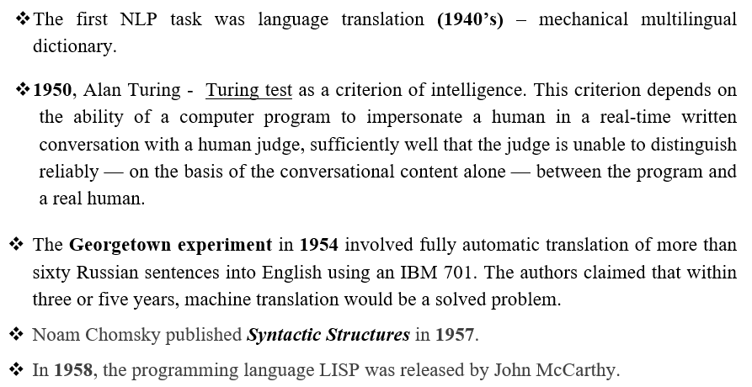
THE HISTORY OF NATURAL LANGUAGE PROCESSING

Slide 36
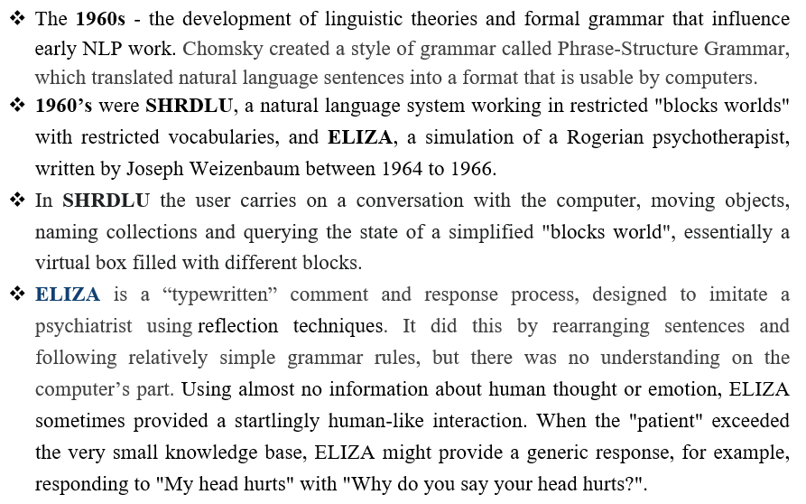
THE HISTORY OF NATURAL LANGUAGE PROCESSING

Slide 37
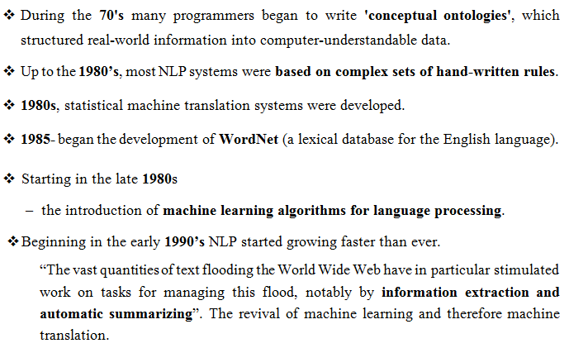
THE HISTORY OF NATURAL LANGUAGE PROCESSING

Slide 38
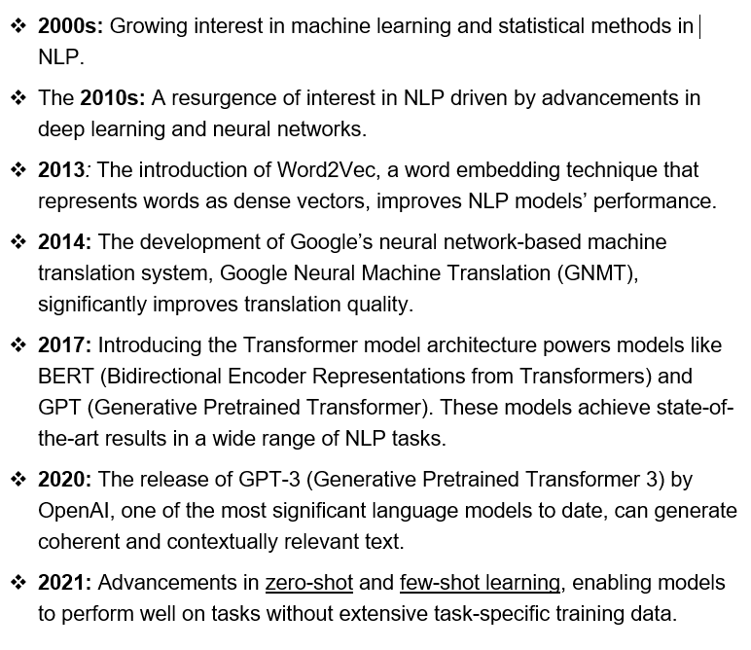
THE HISTORY OF NATURAL LANGUAGE PROCESSING

Slide 39
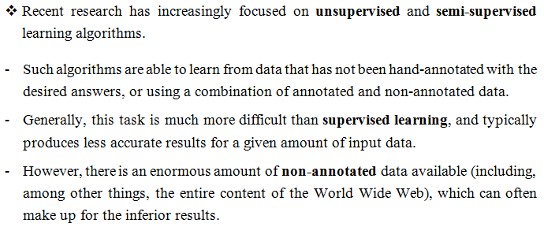
THE HISTORY OF NATURAL LANGUAGE PROCESSING

Slide 40
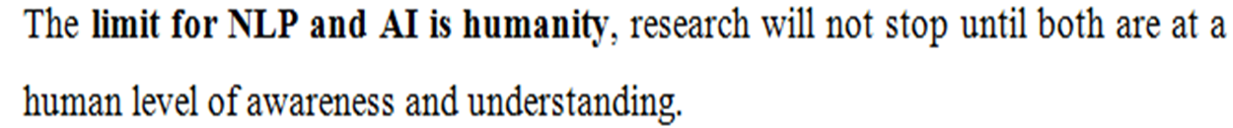
THE HISTORY OF NATURAL LANGUAGE PROCESSING

